Slide 1
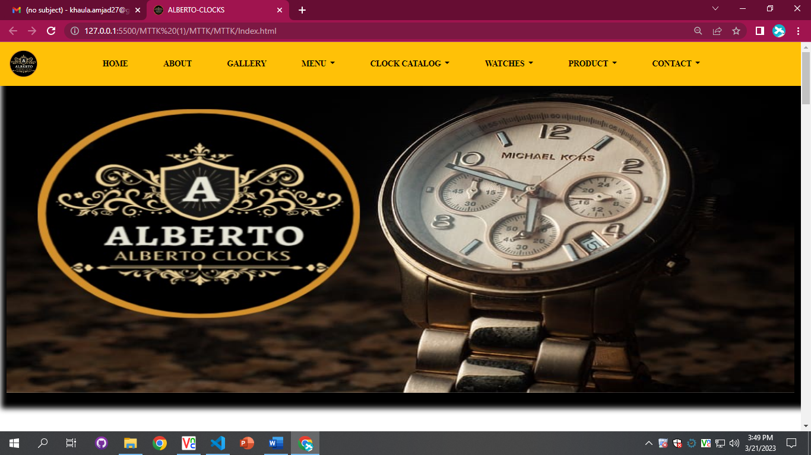

Slide 2
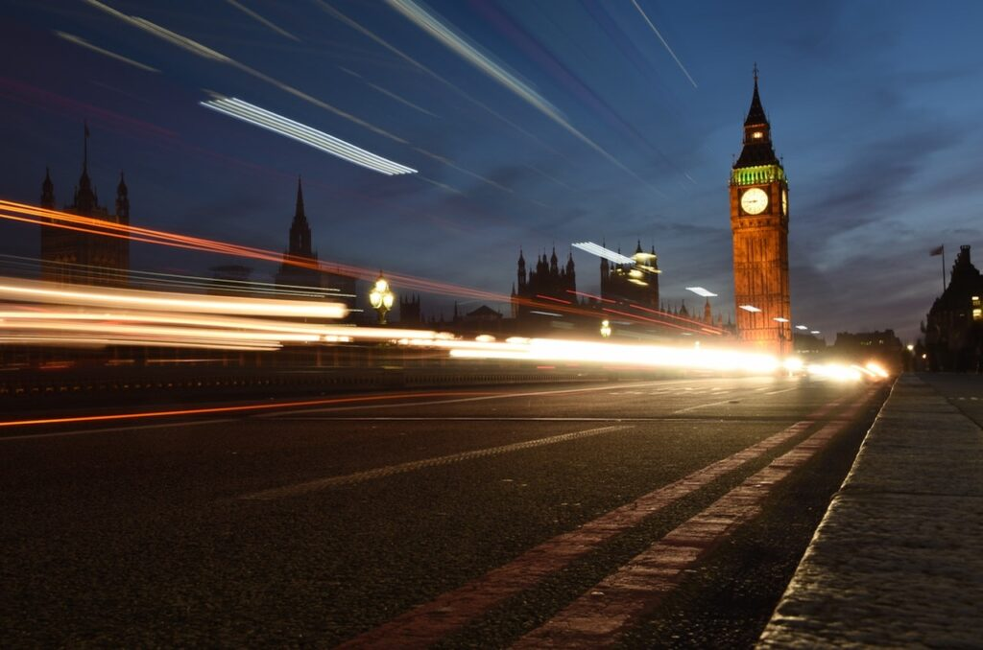
WELLCOME TO OUR WEBSITE
ALBERTO-CLOCKS
Supervisor. | Sir Ebad Uddin
Batch. | 2210E1
Group. | A
Serial No. | Enrollment Number | Student Name
1. | 1424649 | Tayyaba Muslim
2. | 1426353 | Mutayba Kamran
3. | 1425430 | Muhammad Talha
4. | 1425319 | Khula Amjad

Slide 3

Problem Statement
Alberto Watch Company is a full-service watch repair, appraisal, and retail store –
offering the finest selection of luxury timepieces. Offering an unparalleled selection
with first-class service.
Alberto also carries a wide selection of brand new watches such as Michael Kors,
Rolex, Citizen Eco-Drive, Bulova and more!
You are supposed to create a Single-Page-Application and responsive Website for
them with the below mentioned requirement specifications.
The website is to be developed for the Windows Platform using HTML5, JSON,
Angular JS, JavaScript and Geolocation. The site should work well in all leading
browsers including Chrome, IE, Firefox etc.

Slide 4
REQUIREMENTS
The Web site is to be created based on the following requirements.
1) The Top of the Page should be presented with a suitable logo, and page
should have decent colour combination.
2) The site should display a menu which will contain the options as Products,
Technology, Store Locator, Support etc.
3) Various sections having information about different types of watches and
clocks, Technology used in the watches etc. these sections should display
products accordingly.
4) The information should be categorized in sections according to different
Product Line-up e.g. “Vintage”, “Luxury”, “Smart Watches” etc.
5) When a user selects any product line-up, complete list of watches for that
product line-up will be displayeds.
6) Details of the watches should be displayed on the popup window.
7) Price List for all watches should be available.
8) Gallery can be added for viewing different images.
9) Site map, Gallery, about us, Contact us link must be added.
10) About Us and Contact Us: This menu option should display Email id, address,
and contact number of the organization.

Slide 5
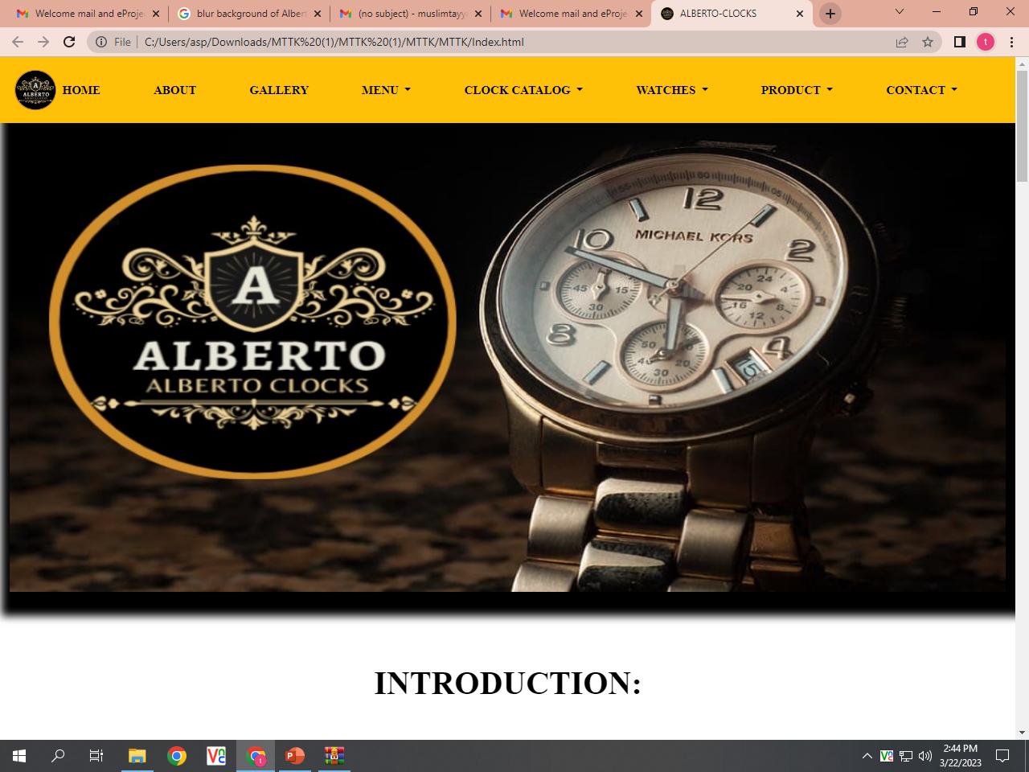
DISCRIPTION OF PAGES
Home Page:
Alberto Olvera Hernández was born on March 2, 1892, at the Coyotepec farm outside the town of Zacatlán, Puebla. He showed a mechanical aptitude early fixing and inventing machines, receiving a patent in 1920 a track changer for electric trains.

Slide 6
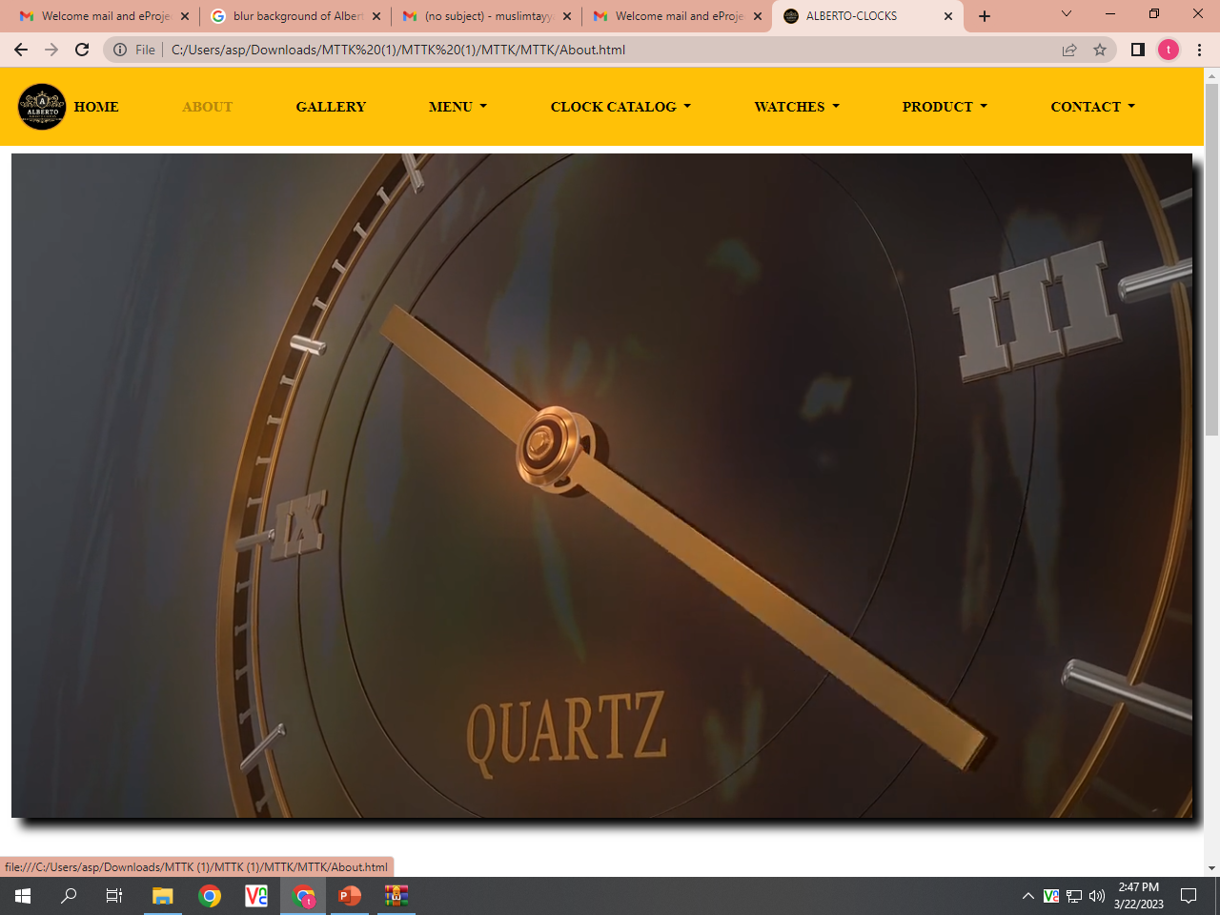
DISCRIPTION OF PAGES
About Page:
Welcome to Alberto Clock, your go-to destination for all things timekeeping. We are a passionate team of clock enthusiasts who are dedicated to providing our customers with the best quality clocks at affordable prices. At Alberto Clock, we understand the importance of time in our daily lives, and we believe that a clock should not just be a functional item but also a beautiful piece of art that adds value to your home or office décor. That's why we offer a wide range of clocks, from classic to modern, that cater to every taste and preference.

Slide 7
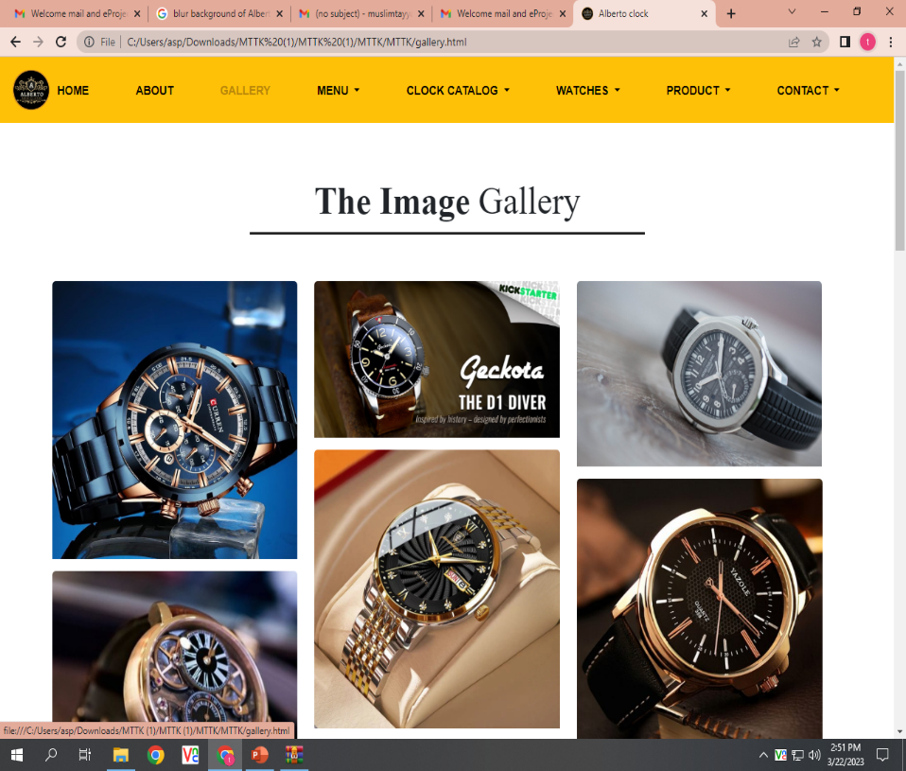
DISCRIPTION OF PAGES
Gallery Page:
We also provide a curated selection of watches for sale, sourced from trusted and reputable brands. Our aim is to offer a range of high-quality and affordable timepieces that are both stylish and functional.

Slide 8
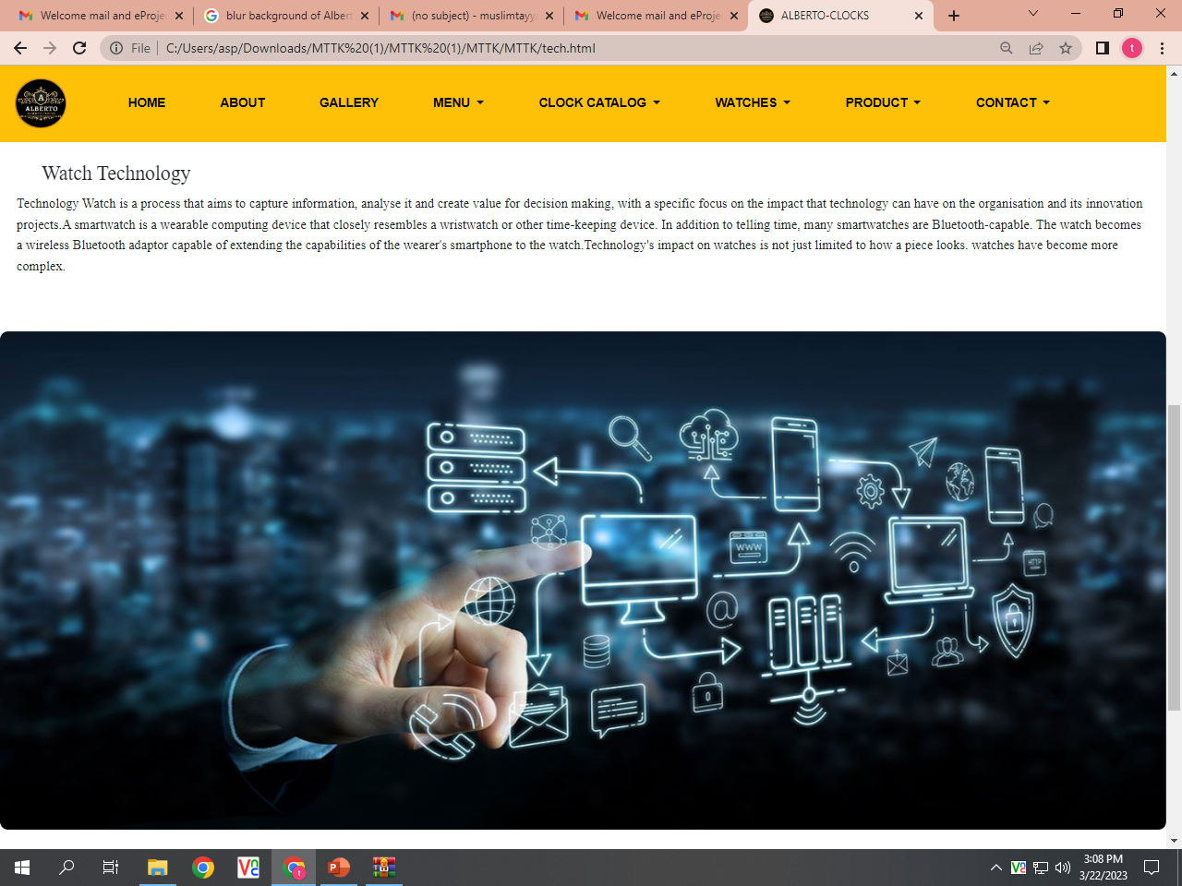
DISCRIPTION OF PAGES
Menu Page:
The word 'clock' derives from the Latin word for bell, and the ringing of bells in central clock towers provided one of the first examples of time-based synchronicity for villagers. The clock has long been a social technology, a way of authorizing a singular source of information to propel collective activity. A clock is a machine in which a device that performs regular movements in equal intervals of time is linked to a counting mechanism that records the number of movements. All clocks, of whatever form, are made on this principle.A clock is a device used to measure, verify, keep, and indicate time.

Slide 9
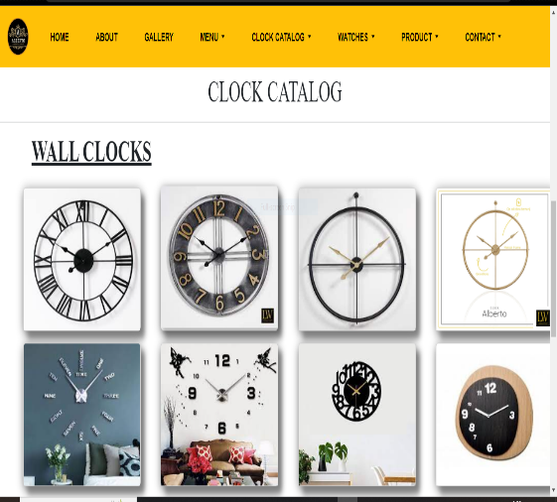
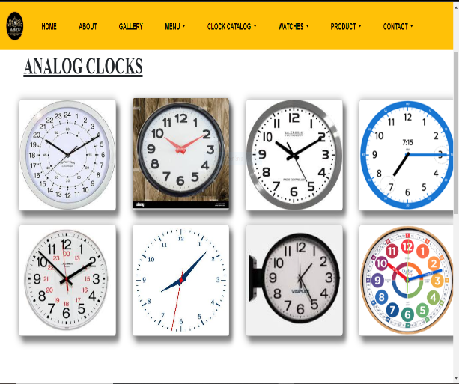
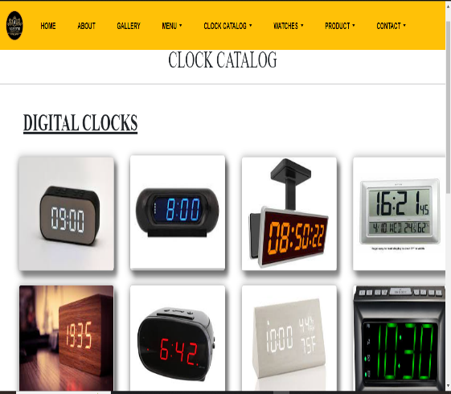
DISCRIPTION OF PAGES
CLOCK CATALOG PAGE:
Clock Catalog have different types of clocks including:
Wall Clock.
Analog Clock.
Digital Clock.

Slide 10
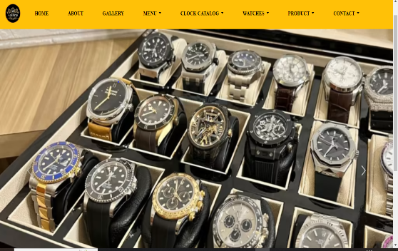
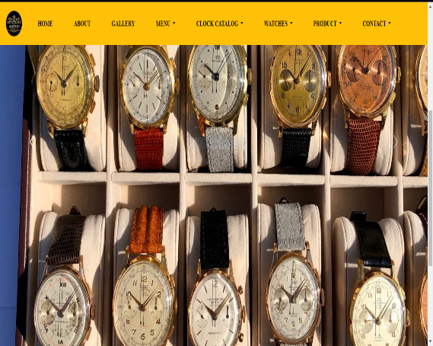
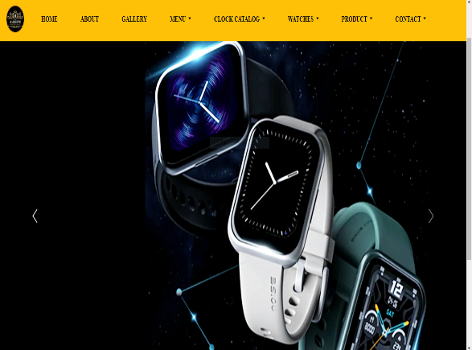
DISCRIPTION OF PAGES
Watches PAGE:
We have different types of Watches including:
Vintage.
Luxury watches.
Smart watches.

Slide 11

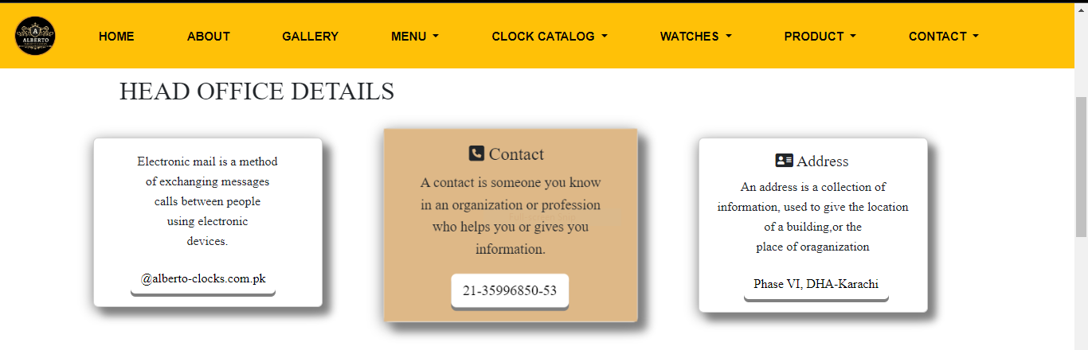
DISCRIPTION OF PAGES
Contact PAGE:
I have variable varieties of Alberto clocks.
If you interested in my products so you will contact us on
VIA SIM/WHATSAPP: 21-35996850-53

Slide 12
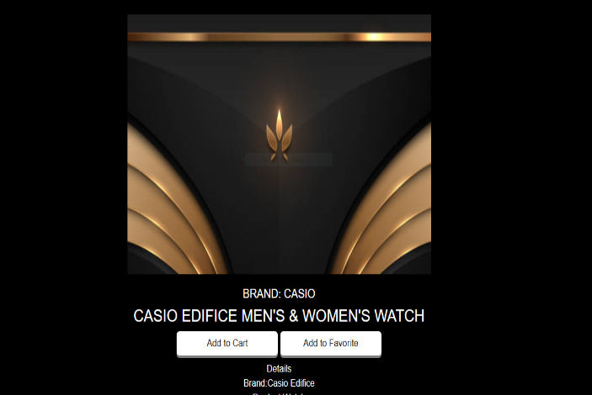
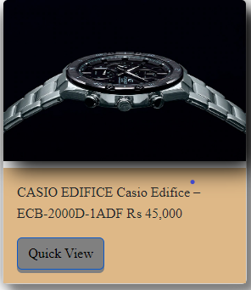
FUNCTIONALITIES
We also use JAVASCRIPT (.js) in buttons and also use different types of animations and transitions for makes our website dynamic and interactive and attractive.
For example:
When a user click on “Quick view (btn)” so the javascrpt can trigger an event such as:
Displaying a page of card which have two options:
Add to card, Add to favourite.

Slide 13
“Remember that success is not just about achieving your goals, but also about the journey you take to get there. It's okay to stumble and face setbacks, as long as you keep moving forward with determination and resilience. Believe in yourself and your abilities, and never lose sight of your dreams. With hard work, persistence, and a positive attitude, anything is possible. So go out there and chase your passions, embrace your challenges, and make your life a masterpiece. The world is waiting for you to shine!”
“THANKYOU SO MUCH FOR WATCHING”

